Slide 1
-: Project Name :-
Farmer’s Helping Portal
Project Guide:-
Mr. Deepak Kadave Sir.

Slide 2
Farmer’s Helping Portal
Project Member:-
Ajinkya Pingale
Shreyas Tikhe

Slide 3
1. Introduction:-
“Farmers Helping Portal”, is based on Informational website It gives accurate information to the farmers.
• User side application
The informational side specifically use for getting information and our website provide detail information of crops which are grow in Maharashtra.
We also provide a accurate knowledge of fertilizers and medicines which are useful for farners and provide them in less cost.

Slide 4
Objective
To create a web based application for farmers.
To provide search facility for customer.
Provide detail information to the farmers.
Provide best quality fertilizers and medicine to the farmers and give them a information about medicine and fertilizers.

Slide 5
Contents:-
Introduction
Project Description
    Proposed System
    Need & Scope of System
    Requirement Analysis
    System requirement

Slide 6
    Deployment Diagram
Data Dictionary
Screen Shots
Advantages
Limitations
Future Enhancements
Conclusion
Bibliography

Slide 7
Proposed System:
In this informational website user can visit to our some web pages but when user want any information about aby crops then he/she want to register on website.
After registration user goes to the login oage directly and after login he goes to his personal webpage where he can see information that he want.

Slide 8
Need of Computerization:
The System must be designed for advertisement of business.
The main objective of the system to provide best quality information to farmers.
To reduce paper work & time required to prepare a online work.
To reduce errors while calculating the Quantity & Amount.
To provide accurate reports/information.
Easy to maintain.
Manual work is reduced.

Slide 9
System Requirement
1) Software:
Category (Software tools) | Software Name
Operating System | Microsoft Windows 7
Front End Development Tool | Notepad , Sublime Text 3
Data base | MySQL
Server | WampServer
2) Hardware:
Hardware | Minimum Requirement
Microprocessor | Intel i5-2540M 2.60 GHz
Random Access Memory | 4 GB RAM.

Slide 10
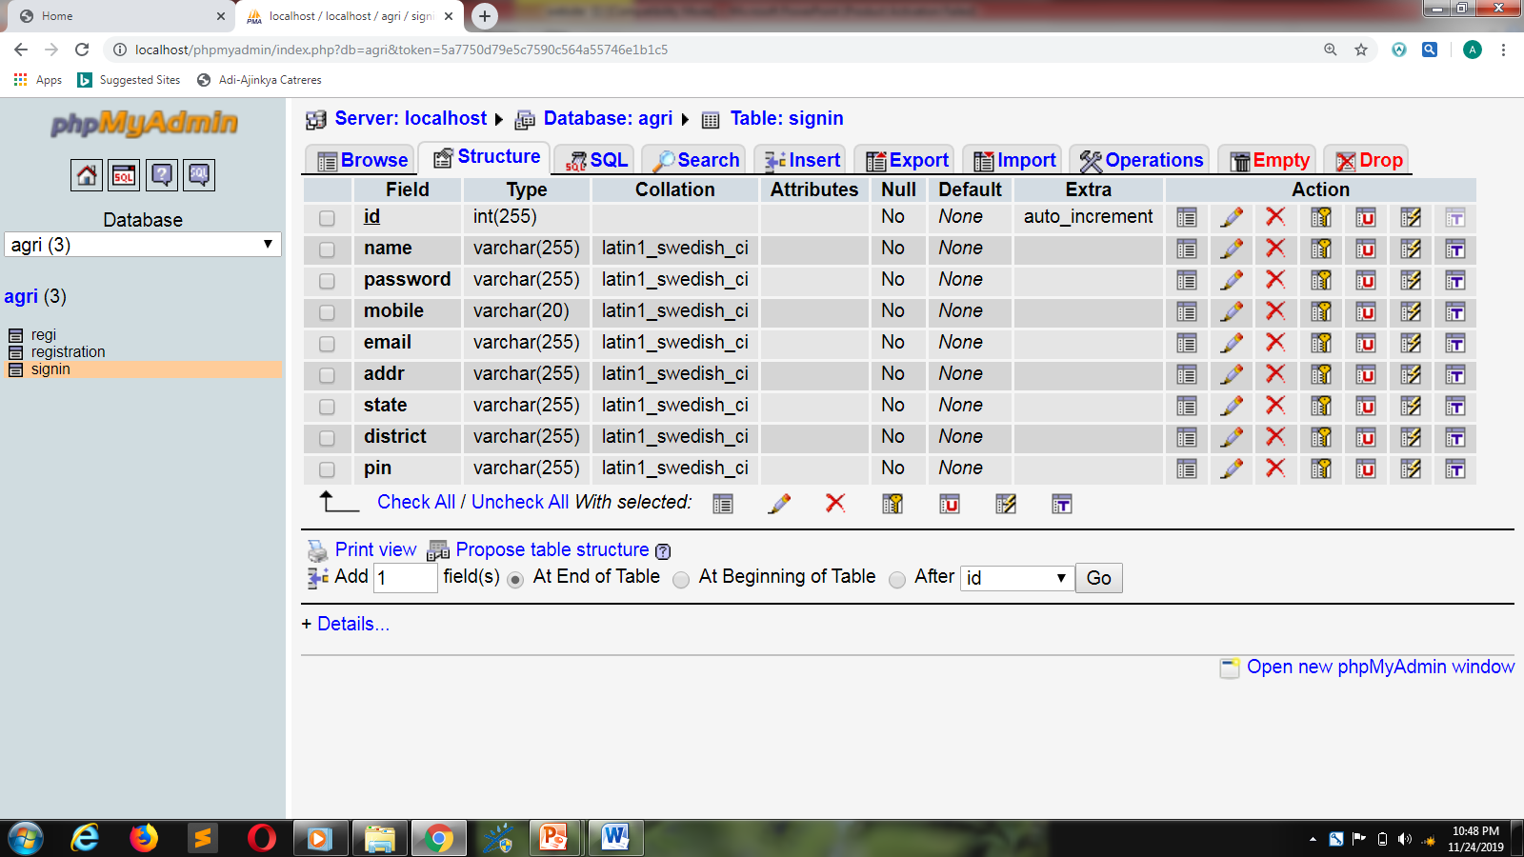
Data Dictionary:-
Registration Table

Slide 11
Screen Design

Slide 12
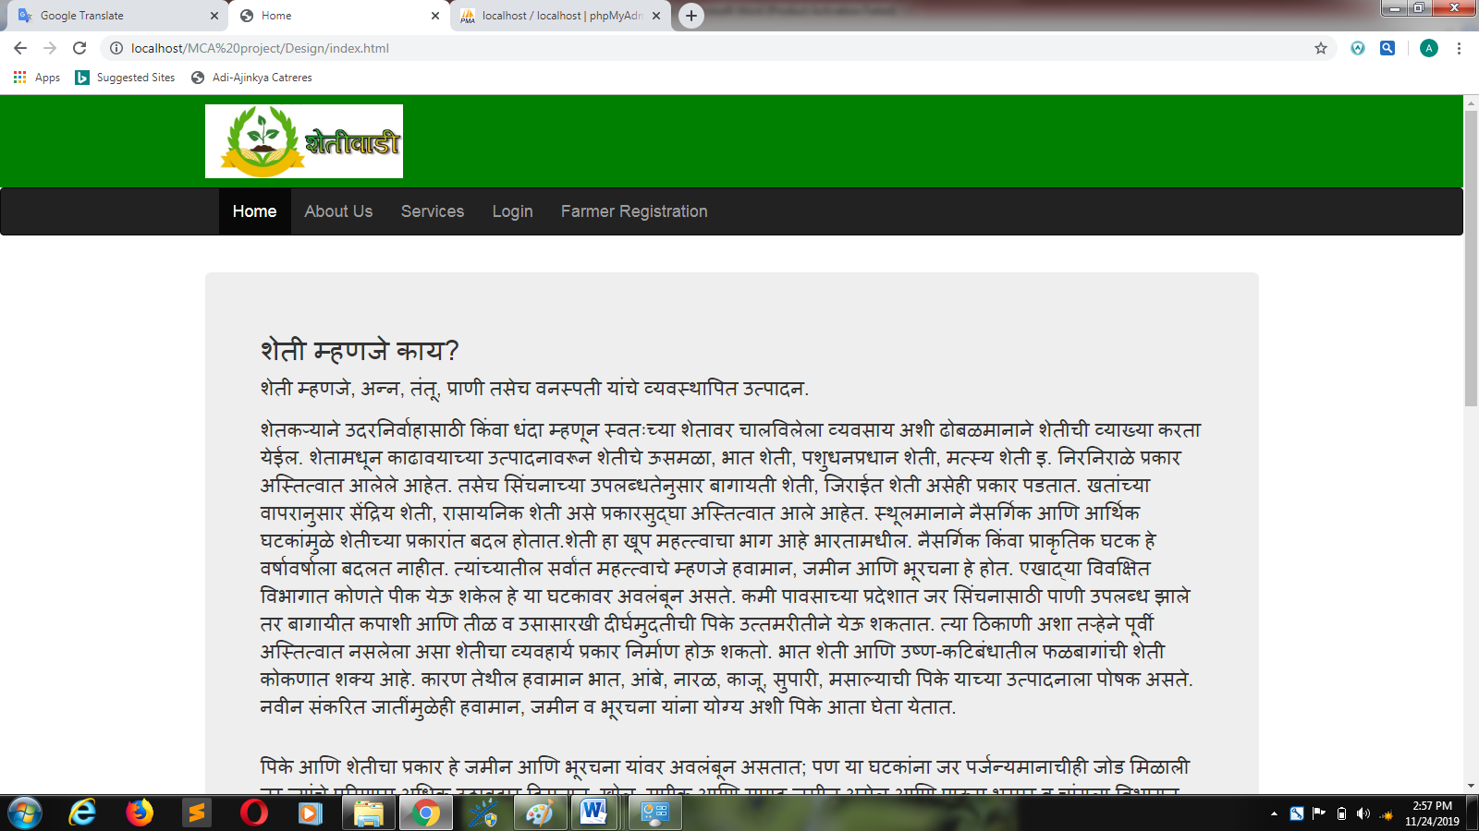
Home page:

Slide 13
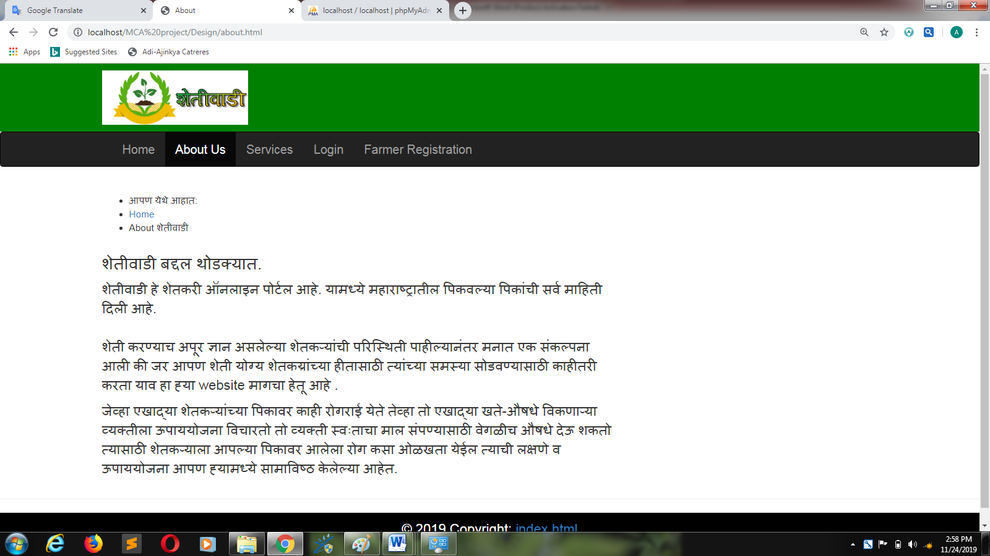
Dishes:

Slide 14
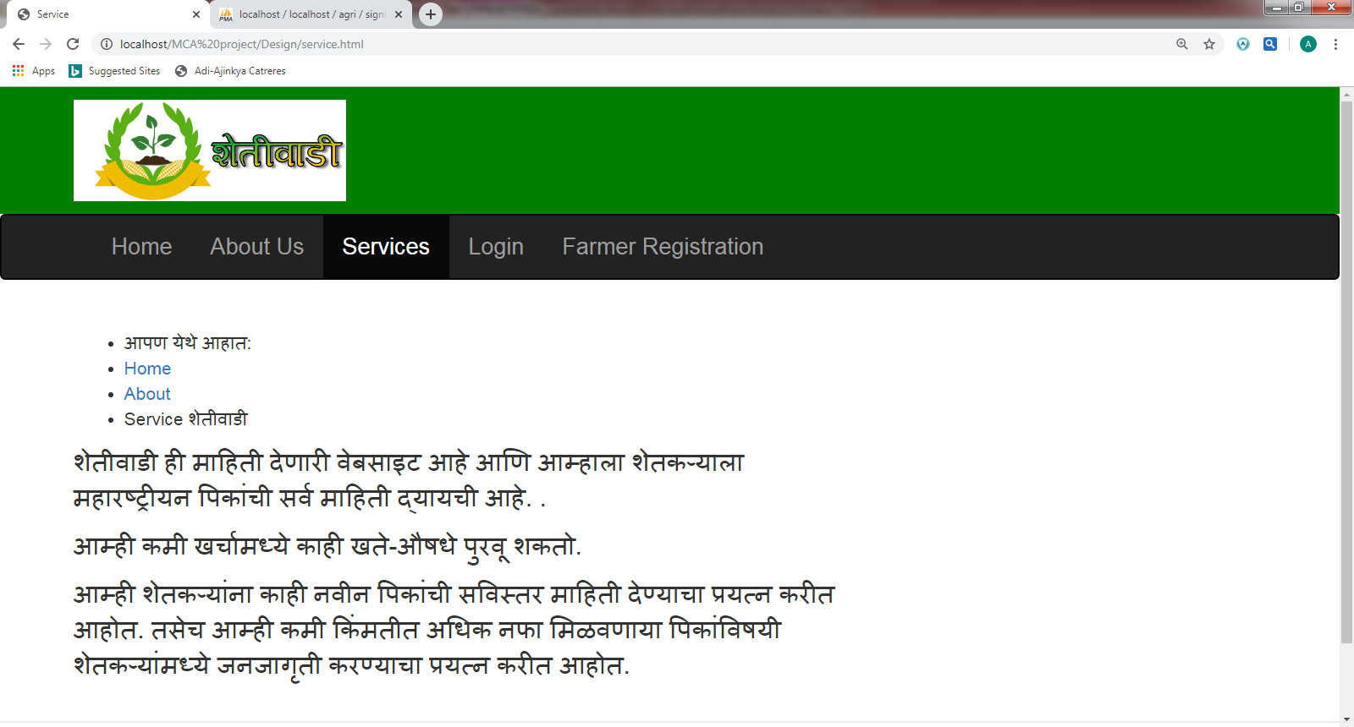
Services:-

Slide 15
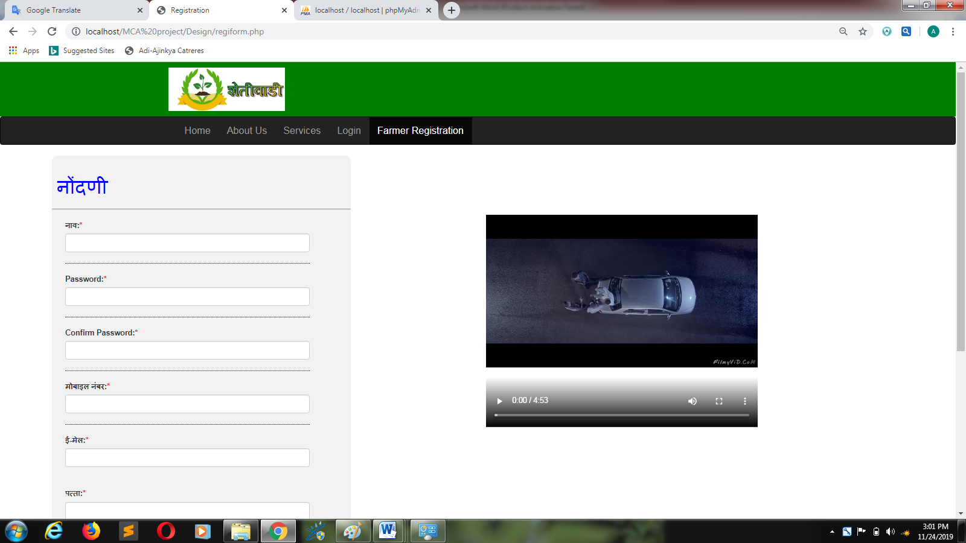
Registration Form:-

Slide 16
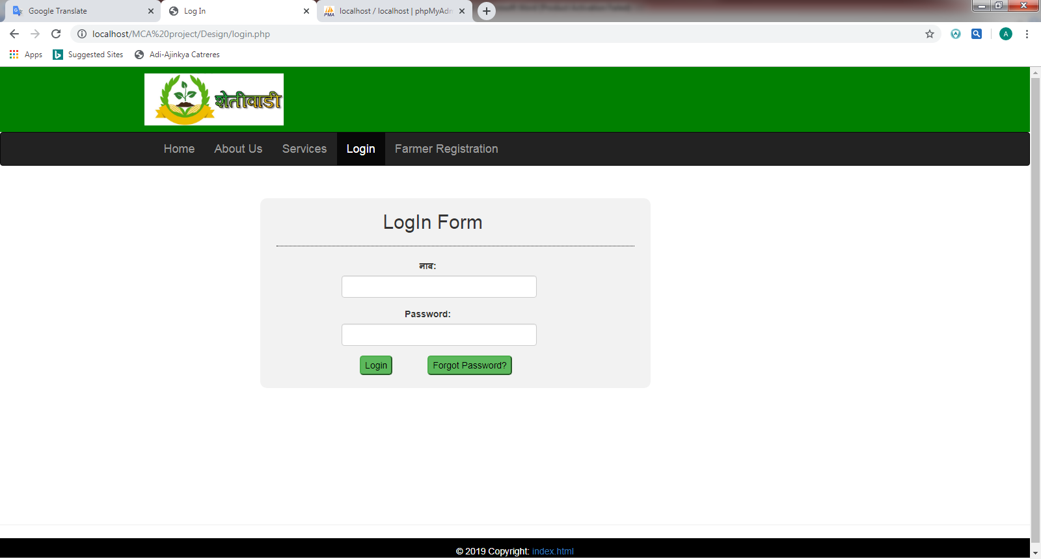
Login Form:

Slide 17
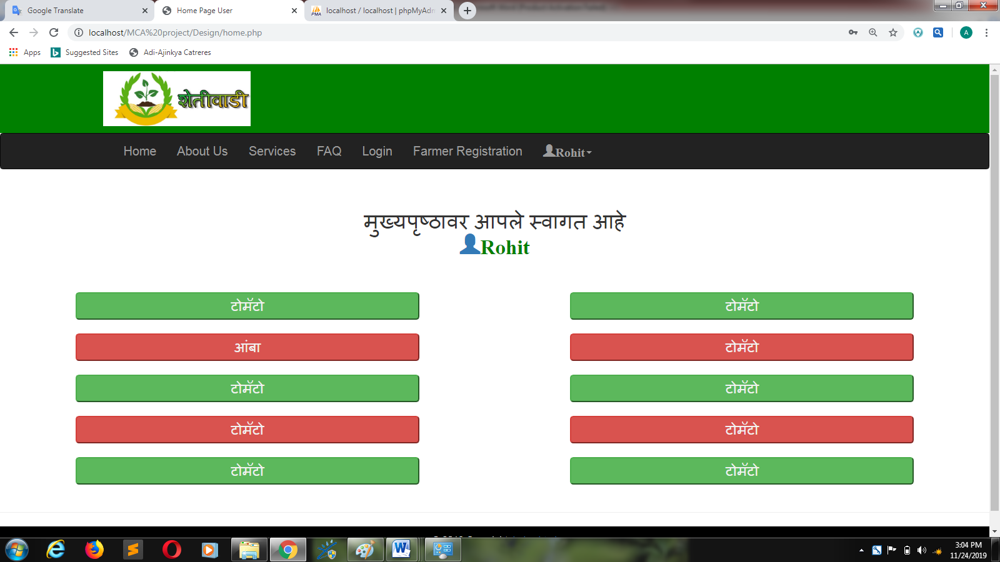
User’s Home Page:

Slide 18
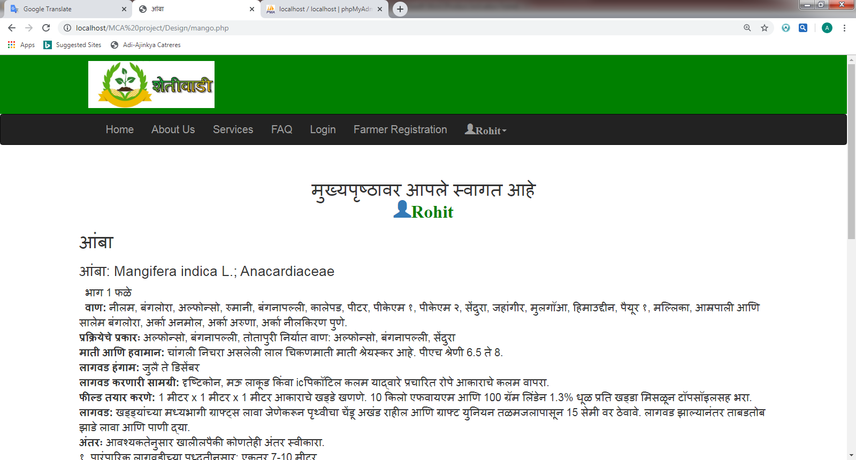
Information Page:

Slide 19
Advantages:
Easy to use for the people eho have less knowledge of computer or mobile phone.
User can’t register fake information cause register form is validated.
Duplicate user name can’t accepted by the server.

Slide 20
Limitations and Drawbacks
Admin does not have a notification about any new registration.
User can’t update his profile.
User can’t have a option for profile image.
Less Security

Slide 21
Future Enhancements
To enhance security and bugs.
Will try to provide the notifications.
All fertilizers shop have to be gathered together to provide best medicines and fertilizers in low cost.
All should be managed online.
Give’s them a option for profile picture.
Give’s them a option for communicate directly to the intelligence of agriculture.

Slide 22
Conclusion
This website gives detail information to the farmers about the crops that he want to grown up in his farm.
Also help to farmer to buy best quality medicines and fertilizers.

Slide 23
Bibliography:-
Books :-
Advanced Web Technology
(published by: A B Nimbalkar)
ONLINE REFERENCE:-
W3school.com
Bootstrap v3.3.7
Youtube Channel- Thapa Technical

Slide 24
THANK
YOU

